Slide 1
Relational Design

Slide 2
DatabaseDesign Process
Conceptual Modeling -- ER diagrams
ER schema transformed to relational schema
Designer may add additional integrity constraints at this stage to reflect real world constraints.
Resulting relational schema is normalized to generate a good schema (schema normalization process)
Schema is tested over example databases to evaluate its quality and correctness
results are analyzed and corrections to schema are made
corrections may be translated back to conceptual model to keep the conceptual description of data consistent
Design tools automate some of the schema transformation, normalization, generation of example database to test the schema design, as well as evaluation.
Good Book: The design of relational databases, by Mannila and Raiha, Addison Wesley

Slide 3
Schema Normalization
Normalization process “decomposes” the relational schemes to
  remove redundancy
  remove anomalies
Results in a semantically equivalent relational scheme that represents the same information as the original:
  must be able to reconstruct the original from the decomposed relations.

Slide 4
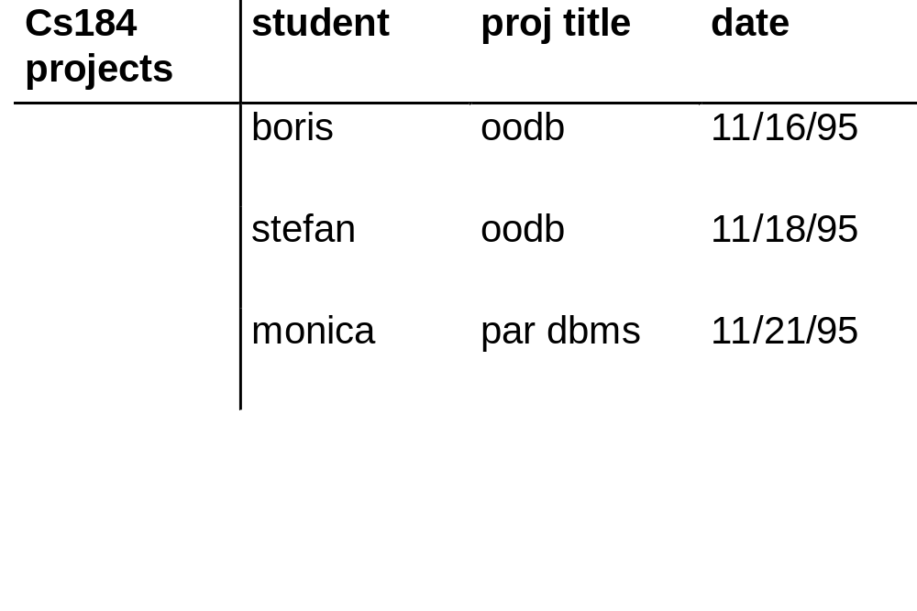
Examples of Redundancy and Anomalies in Relational Scheme
Redundancy:
  date of presentation repeated per member of project group

Slide 5
Redundancy leads to Anomalies
Update Anomaly:
  if we modify presentation date for the oodb project, we need to modify the date in each of the tuples in which it is stored (one per member). Else, database will be inconsistent.

Slide 6
More Anomalies...
Insertion Anomaly: how to insert that the presentation on multimedia databases has been set for 12/1/95 without associating any students first with the project. (possible solution: use null values in the student field)

Slide 7
More Anomalies ...
Deletion Anomaly:how to delete the fact that monica dropped out of the project without deleting information about the par dbms project. (possible solution: use null values in the student field)

Slide 8
Redundancy and Integrity Constraints
An IC means that only a subset of all possible relations are ‘legal’ (representing possible states of the real world)
Thus, given some information about the current values of the relations and the set of IC, we can possibly deduce some more information about the current information of the relation (since it must be a legal state)
Thus, presence of ICs will possibly always result in redundancy
For certain ICs redundancy is more obvious as compared to other Ics
We will study redundancy due to functional dependencies only.
However, remember that redundancy might be present due to lots of other constraints (e.g., multi-valued dependency) we will ignore such redundancy in this course.

Slide 9
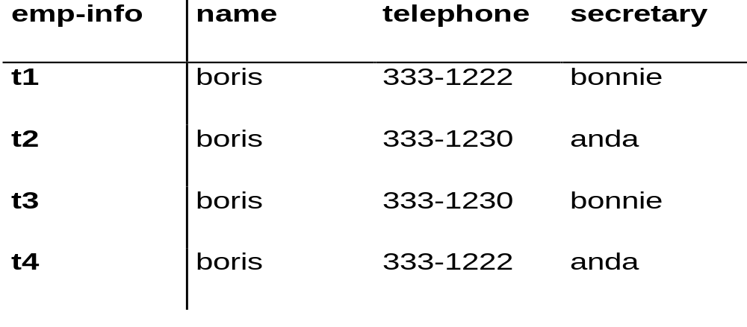
Redundancy Due to Multi-valued Dependency
MVD:
  name telephone
MVD tells us that if tuples t1 and t2 are present in the relation, then tuples t3 and t4 must also be present (redundancy --- since we could have deduced them using t1 and t2 + MVD)!

Slide 10
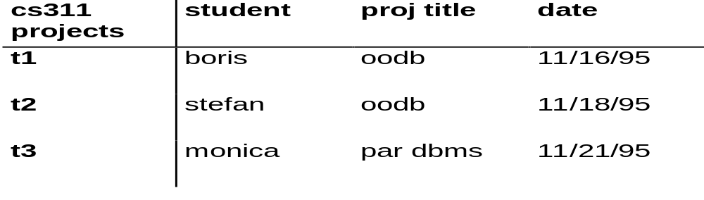
Redundancy due to Functional Dependency
Functional dependencies:
student projtitle date
projtitle date
date projtitle
Notice that time in tuple t2 could be deduced using the FDs + tuple t1 + remaining of tuple t2. (redundancy!!)
We will examine how to get rid of redundancy due to functional dependencies.
Henceforth we will assume that the only dependencies present are functional.

Slide 11
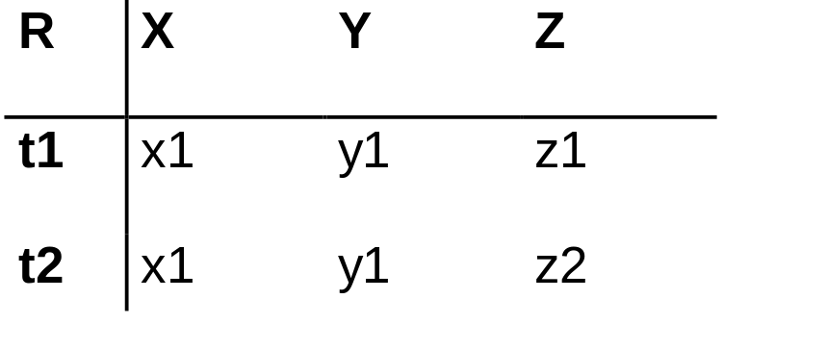
When does a relation contain no redundancy due to FDs?
Assume functional dependency: X Y
Since t1[X] = t2[X], we have that t1[Y] = t2[Y] (redundancy- since we can deduce the value of t2[Y] using FD
However, if X is a superkey of R, then it must be the case that t1[Z] = t2[Z]. Thus, t1 = t2 and hence there cannot be such a tuple t2 R (a relation is a set).
Thus, a relation does not contain redundancy if for each FD X Y that holds on R, X is a superkey.
Such a relational scheme is said to be boyce-codd normal form

Slide 12
Boyce Codd Normal Form
Let R be a relation scheme. F be the functional dependency set. R is in BCNF if for all functional dependencies X Y in F+, either Y is a subset of X, or X is a superkey.
X is a superkey for R if X A1, A2, ..., An is in F+, where A1,A2, ....An is the set of attributes of R.

Slide 13
Testing for BCNF
Let R be a relation scheme. Let F be the set of functional dependencies. Is R in BCNF?
R is in BCNF if for each functional dependency X Y in F+, either Y is a subset of X, or X is a superkey.
note:
For each functional dependency X Y in F+, either Y is a subset of X or X is a superkey, if and only if, for each functional dependency X1 Y1 in F, either Y1 is a subset of X1, or X1 is a superkey
Hence, to test for BCNF, we only need to test that for all functional dependencies X Y in F, either Y is a subset of X or X is a superkey.

Slide 14
Testing if X is a superkey
Let R be a relation scheme and F be the set of functional dependencies. To test if X is a superkey of R.
X is a superkey if X A1, A2, ..., An holds, where A1, A2, ..., An are the se t of attributes in R.
Hence, we can test if X is a superkey by testing for the membership of X A1, A2, ..., An in F+.

Slide 15
Computing Closure of F
We could test for whether a relation scheme is in BCNF, if we could compute the closure of F.
Closure of F can be computed using the Armstrongs Axioms.
Not very practical since the size of F+ can be really very large.
Example:
Let F = {A B1, A B2, ..., A Bn} (cardinality of F = n)
then
{A Y | Y is a subset of {B1, B2, ..., Bm}} is a subset of F+
(cardinality of F+ is more than 2^n).
So computing F+ may take exponential time!

Slide 16
Membership of F+
Fortunately, to test for BCNF we do not need to compute closure of F.
Instead we only need to test if a dependency X Y is in F+
Testing for membership in F+ can be done efficiently.
To develop an algorithm for testing membership in F+, we need to define the notion of a closure of a set of attributes
Closure of attribute set:
Let R be a relation scheme and F be the functional dependency set. Closure of a set of attributes X with respect to F denoted by X+ is the set of attributes Ai of R such that X Ai can be derived using Armstrong Axioms.
Note: X Y holds over R if and only if Y is a subset of X+.

Slide 17
Membership of F+
Since X Y holds over R if and only if Y is a subset of X+,
we can check if X Y holds by computing X+ and testing if Y is a subset of X+.
Hence X Y is a element of F+ if and only if Y is a subset of X+
Computing X+
X+ = X repeat oldX+ = X+ for each fd Y Z in F do if (Y is a subset of oldX+) then X+ = X+ union Z endif endfor until (oldX+ == X+)
maximum number of iterations = cardinality of F times the number of attributes in R!
(polytime)

Slide 18
Example
Let the set F contain the following fds:
AB C, D EG, C A, BE C, BC D
CG BD, ACD B, CE AG
Let X = BD. Compute X+.
iteration 1: X+ = {BD}
iteration 2: X+ = {BDEG} (due to dependency 2)
iteration 3: X+ = {BDCEG} (due to dependency 3)
iteration 4: X+ = {BCDEGA} (due to dependency 8)
iteration 5: X+ = {BCDEGA}
Algorithm exits the loop since no new attribute added in last iteration and (BD)+ = {ABCDEG}

Slide 19
BCNF Examples
Example of a BCNF relation scheme
  relation R(A, B, C, D)
  FD = {A B, B C, C D, D A}
Example of a relation scheme which is not BCNF
  relation R(A, B, C, D)
  FD = {A B, B C, C D}

Slide 20
Eliminating Redundancy from Relations
So we can eliminate redundancy by decomposing a relation R containing redundancy into a set of relations (R1, R2, ..., Rn) such that each Ri is in BCNF.
Not so fast ….
  We further need to ensure that decomposed relations R1, R2, …, Rn represent the same information as R.
  That is, we can reconstruct R from R1, R2, …, Rn by taking their natural joins

Slide 21
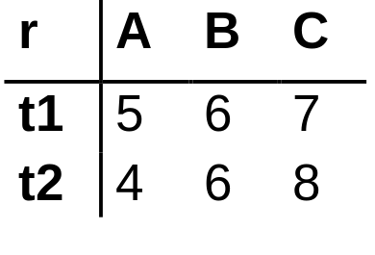
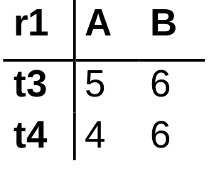
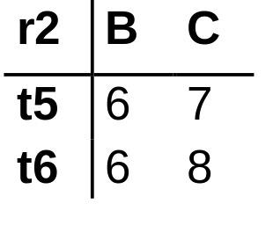
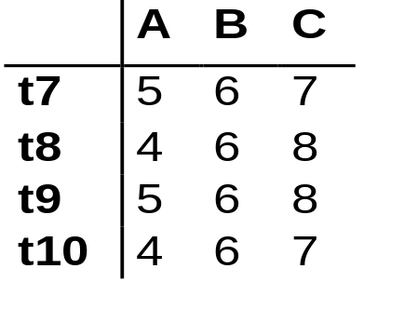
Lossless Joins
Let R be a relation schema and let (R1, R2, ... Rn) be its decomposition.
Let r be any instance of R. Thus, r[R1], r[R2], ... r[Rn] are instances of R1, R2, ..., Rn
The decomposition should be such that we can reconstruct relation r from r[R1], r[R2], ... r[Rn] using natural joins
r is a subset of r1 r2
hence the join is lossy!
ICs can help us identify when joins are lossless!

Slide 22
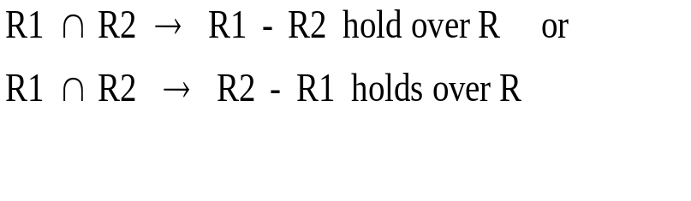
Testing for Lossless Join Decomposition
Theorem:
Let R be a relation with the set of functional dependencies F.
Let R1 and R2 be a decomposition of R.
The decomposition is lossless if and only if either of the following holds

Slide 23
Intuition behind Loss less decomposition test
Say R = (A,B,C) R1 = (A,B) R2 = (B,C)
If decom of R into R1 and R2 is lossy, then
  there exists a tuple (a1, b1, c1) in R1 [ ..] R2 which is not in R
Since (a1, b1, c1) in R1 [ … ] R2
  there exists a tuple (a1, b1) in R1 and (b1, c1) in R2
Since (a1, b1) in R1 and (b1, c1) in R2
  there exists tuples (a1, b1, c2) and (a2, b1, c1) in R where c1 <> c2 and a1 <> a2
As a result neither functional dependencies B--> A nor B --> C hold in R.
Hence if decomposition is lossy, then the FDs B--> A and B-->C do not hold.
That is, if either of the FDs hold, then the decomposition is lossless.
This proves that whenever the test succeeds the decom is lossless. Try proving that whenever the FDs do not hold then the decom is lossy on your own.

Slide 24
What if Decomposition consists of more than 2 subschemes.
Consider the decomposition as a sequence of binary decompositions and test for losslessness at each step.
If each decomposition in the sequence is lossless, then the original decomposition is lossless.
However, it may not be always possible to consider a decomposition as a sequence of binary decompositions!
So this approach cannot be used in general.
Read the more general approach in the Book.

Slide 25
Example
Lossless since B A
R(A,B,C, D, E)
R1(A,B)
(B,C, D, E)
R2(B,C, D)
R3( D, E)
Lossless since D E
FD = {B A, D E}
Since both the decompositions in the sequence lossless, the complete decomposition of R into (R1, R2, R3) is lossless

Slide 26
Example of a lossless Decomposition for which no sequence of binary lossless decomposition exists
R = ABCD
D = {AB, BCD, ACD}
F = {A--> C, B -->D}
{AB, BCD} is not lossless
{AB, ACD} is not lossless
{BCD, ACD} is not lossless.
But {AB, BCD, ACD} is lossless -- check it out using a examples!
You cannot show this using a sequence of binary decompositions.
Can you develop a general strategy for testing losslessness of decompositions?

Slide 27
Proof why the decomposition is loss less
R = ABCD D = {AB, BCD, ACD}
FD = {A--> C, B ---> D}
Say that D is lossy.
Then there exists a tuple (a1, b1,c1, d1) in AB […] BCD […] ACD such that (a1, b1,c1, d1) is not in R.
Since (a1, b1,c1,d1) is in the join, there exists tuples (a1,b1), (b1,c1,d1), and (a1,c1,d1) in AB, BCD and ACD respectively
Hence there exists tuples t1, t2, t3 in R (not necessarily distinct) such that:
  t1 = (a1, b1, c2, d2)
  t2 = (a2, b1, c1, d1)
  t3 = (a1, b2, c1, d1)
Since A --> C and since the value of attribute A in t1 and t3 is the same, c2 must equal c1. Similarly since B --> D d2 must equal d1.
As a result t1 is (a1, b1, c1, d1). Hence our assumption was wrong and the decomposition is lossless.

Slide 28
Schema Normalization
So we have learnt that if a relation R contains redundancy, we need to decompose it into subrelations R1, R2, …, Rn such that
  each Ri is in BCNF, and
  the decomposition of R into R1, R2, …, Rn is a lossless decomposition.
It is always possible to come up with such a decomposition. Is this good enough??
Not so fast again ….
  The decomposition must be such that ALL integrity constraints that hold over the original schema must also hold over the new schema.
  Once again, we will consider only preservation of functional dependencies and ignore all other dependencies. In reality, other integrity constraints such as MVD, Inclusion dependencies,etc. must hold

Slide 29

Functional Dependency Preservation
Let R be a relation scheme.
F = functional dependency set.
(R1, R2, ..., Rn) be a decomposition of R.
Fi = projection F+ to Ri.
decomposition of R into (R1, R2, ..., Rn) is dependency preserving if:
for all fds X Y in F+, X Y is also in G+.
Projection of F+ to Ri is the set of fds X Y in F+ such that XY is a subset of Ri.

Slide 30
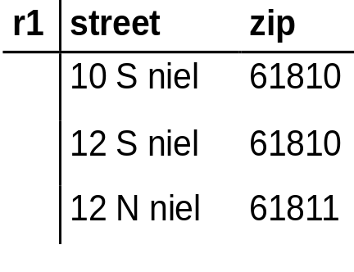
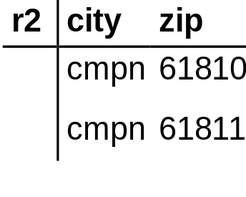
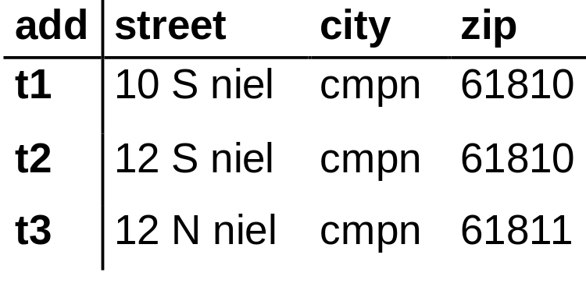
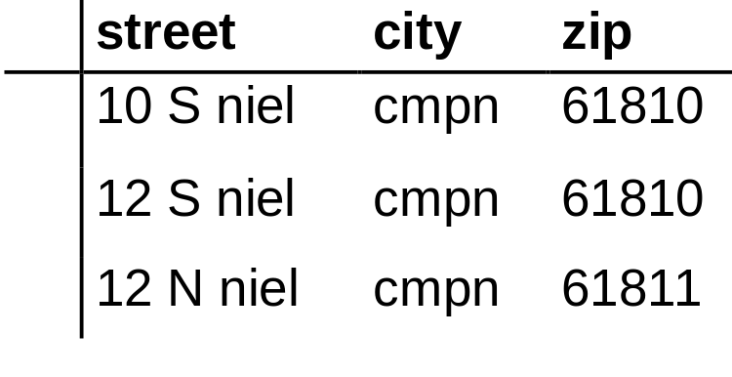
Example of a Non-Dependency Preserving Decomposition
FD:
street city zip
zip city
add == join of r1 and r2!
add contains redundancy - city name repeated for every entry of zip code!
lossless decomposition

Slide 31
Dependency Preservation
decomposition of add into r1 and r2 is lossless.
Furthermore, r1 and r2 do not contain any redundancy --(BCNF)
however, the decomposition does not preserve the following functional dependency.
  street city zip

Slide 32
Testing for Dependency Preservation

Slide 33
Finally what we wish of Schema Normalization
Given a relation R which contains redundancy, we desire a decomposition D of R into a set of subschemas R1, R2, ..., Rn s.t.
  the decomposition is lossless
  the decomposition is dependency preserving
  the subschemes R1, R2, ..., Rn does not contain redundancy (BCNF)
Unfortunately, such a decomposition may not always exist.
  Example: R(A,B,C) F = {AB C, C B}

Slide 34
So What can we do?
allow for some redundancy:
  cons: storage overhead, anomalies.
do not preserve dependency:
  cons: either we will have a possibility of an inconsistent database, or alternatively, every time there is an insertion we will need to take a join to reconstruct the original relation R and check if the dependency that is not preserved by the decomposition is not violated by the insertion.

Slide 35
Third Normal Form
Let R be a relation scheme and F be a set of functional dependencies. R is in 3NF if for all fds X A in F+, either of the following three holds:
A is in X
X is a superkey of R
A is prime.
Prime Attributes: An attribute A is prime if it is part of some candidate key.
Key: X is a key for R if it satisfies the following two conditions:
X is a superkey for R.
No proper subset of X is a superkey for R.

Slide 36
Examples
Let R = (city, street, zip)
FDs:
fd1: zip city
fd2: city street zip
KEYS
(city, street), (zip, street)
Since zip is not a superkey, R is not in BCNF.
Is R in 3NF?
  Testing for 3NF requires us to list out all the functional dependencies in F+ and check if they do not violate the requirements of 3NF.
  This example is easy to check since each attribute of R is prime.Thus, R must be in 3NF!

Slide 37
Examples
Let R = (supplier, address, item, price)
FDs
supplier address
supplier item price
KEYS
(supplier, item)
PRIME ATTRIBUTES
(supplier, item)
R is not in 3NF since for the fd supplier address, address is not prime and supplier is not a superkey.
Since R is not in 3NF it is not in BCNF.

Slide 38
Taking Advantage of 3NF
Theorem: For any relation R and set of FD's F, we can find a decomposition of R into 3NF relations, such that if the decomposed relations satisfy their projected dependencies from F, then their join will satisfy F itself.
In fact, with some more effort, we can guarantee that the decomposition is also "lossless"; i.e., the join of the projections of R onto the decomposed relations is always R itself, just as for the BCNF decomposition.
But what we give up is absolute absence of redundancy due to FD's.
Notes:
7

Slide 39
How to test Whether Subschemes in BCNF??
Let S be a subscheme of R.
To test whether S is in BCNF, we need to test whether for each fd X --> Y that holds in S, X is a superkey of S.
However, this means we need to figure out the set of functional dependencies that hold on S.
Algorithm to compute the set of FD’s that hold on S
  For each X that is a subset of S Do /* note that this is in general exponential*/
    Compute X+
    For each attribute B s.t.
      B is in S
      B is in X+
      B is not in X
    the functional dependency X ---> B holds in S

Slide 40
Example (1)
Let R have a schema R(A,B,C,D)
S have a schema S(A,C)
FD over R be A --> B and B --> C
Compute A+ == {A,B,C}
  hence dependencies A --> C holds in S
Compute C+ == {C}
  no new dependency gets added.
Compute {AC}+ == {ABC}
  since {AC}+ is the same as {A}+, no new dependecy gets added.
In general you can limit search as follows:
  it is not necc. To consider the closure of the set of all S’s attributes
    For example, {AC}+ need not have been considered in the above example
  Not necc. To consider a set of attributes that does not contain the lhs of any dependecy.
    {C}+ need not have been considered in the above example
  Not necc. To consider a set that contains an attribute that is not in the lhs of any functional dependency
    {AC}+ need not have been considered in the above example.

Slide 41
Example (2)
Consider R(A,B,C,D,E) and S(A,B,C)
FD on R be A -->D, B ---> E, DE --> C
Compute {A}+ == {A,D}
  no dependency gets added.
Compute {B}+ == {BE}
  no dependency gets added
{C}+ does not need to be considered since {C} not in lhs of any dep.
Compute {AB}+ == {A,B,C,D,E}
  add dependency AB -->C
{AC}+ and {BC}+ do not need to be considered since {C} not in lhs of any dep.
Since {AB}+ == all attributes in R, {ABC} need not be considered.
Hence, the only dep. On S is AB ---> C

Slide 42
Design Algorithms
Next we will study the following algorithms:
  algorithm to decompose a relational schema into subschemas which are in BCNF such that the decomposition is lossless (the decomposition may not be dependency preserving though).
  Algorithm to decompose a relational schema into subschemas which are in 3NF and the functional dependencies are preserved (synthesis algorithm) (the decomposition may not be lossless)
  modified synthesis algorithm that ensures that the decomposition is also lossless. Such a decomposition can always be found!

Slide 43
Decomposition to Reach BCNF
Setting: relation R, given FD's F. Suppose relation R has BCNF violation X -> A.
Notice: we need only look among FD's of F, because any nontrivial FD that follows from them must contain one of their left sides in its left side.
Thus, any FD that follows and has a non-superkey as a left side means there is an FD in F with the same property.
Notes:
14

Slide 44
Decomposition to Reach BCNF (II)
1. Expand right side to include X⁺.
  Cannot be all attributes | why?
2. Decompose R into X⁺ and (R - X⁺) ∪ X.
X⁺
X
R
3. Find the FD's for the decomposed relations.
    Project the FD's from F = calculate all consequents of F that involve only attributes from X+ or only from (R - X⁺) ∪ X.
4. Iterate over all the resulting sub schemes until all in BCNF
Notes:
15

Slide 45
Example
R = Drinkers(name, addr, beersLiked, manf, favoriteBeer)
F --
    1. name -> addr
    2. name -> favoriteBeer
    3. beersLiked-> manf
Pick BCNF violation name -> addr.
Expand right side:
name -> addr favoriteBeer.
Notes:
18

Slide 46
Example (II)
Decomposed relations:
Drinkers1(name, addr, favoriteBeer)
Drinkers2(name, beersLiked, manf)
Projected FD's (skipping a lot of work that leads nowhere interesting):
  For Drinkers1: name -> addr and name -> favoriteBeer.
  For Drinkers2: beersLiked -> manf.
Notes:
19

Slide 47
Example (III)
BCNF violations?
  For Drinkers1, name is key and all left sides are superkeys.
  For Drinkers2, {name, beersLiked} is the key, and beersLiked -> manf violates BCNF.
Notes:
20

Slide 48
Decompose Drinkers2
Expand: nothing.
Decompose:
Drinkers3(beersLiked, manf)
Drinkers4(name, beersLiked)
Resulting relations are all in BCNF:
Drinkers1(name, addr, favoriteBeer)
Drinkers3(beersLiked, manf)
Drinkers4(name, beersLiked)
Notes:
21

Slide 49
BCNF Decomposition
Claim: The BCNF decomposition algorithm described results in lossless decompositions.
Proof. Sketch: since at each step a relational scheme R is decomposed into X+ and (R - X+) union X. Since X functionally determines X+, the decomposition is lossless.

Slide 50
Decomposition into 3NF subschemes
The "obvious" approach of doing a BCNF decomposition, but stopping when a relation schema is in 3NF, doesn't always work -- it might still allow some FD's to get lost.
Construct such an example to convince yourself!
We will instead study a different approach referred to as the synthesis algorithm.
However, before describing the synthesis algorithm, we need to define the canonical cover of FDs
Notes:
8

Slide 51
Roadmap
1. Define canonical cover of FDs.
  Requires study of when two sets of FD's are equivalent, in the sense that they are satisfied by exactly the same relation instances.
2. Give the algorithm for constructing a decomposition into 3NF schemas that preserves all FD's.
  Called the synthesis algorithm.
3. Show how to modify this construction to guarantee losslessness.
Notes:
9

Slide 52
Canonical cover of FDs
A canonical cover of a set F of FDs is a set G of FDs such that:
  (1) The closure of F is equal to the closure of G (that is, F+ = G+)
  (2) No functional dependency in G contains an extraneous attribute
  (3) Each LHS of a functional dependency in G is unique. That is, there are no two dependencies X Y, X1 Y1 where X = X1.
Consider a set F of fds and a fd X Y in F.
  attribute A is extraneous in X if A is an element of X and F logically implies (F - { X Y} ) union {(X - A) Y}
  attribute B is extraneous in Y if B is an element of Y and the set of functional dependencies (F - {X Y}) union {X (Y - B)} logically implies F.
Intuitively, a canonical cover of F is an equivalent set of FDs that is minimal in 2 respects:
  (1) every dependency is as small as possible (that is, each attribute on the LHS is necessary)
  (2) Every dependency is required in order for the closure to be equal to F+

Slide 53
Algorithm to Compute Canonical Cover
Use the union rule to replace any dependency X Y and X Z with X YZ.
Test each fd X Y to see if there is an extraneous attribute in X. If so remove it.
Test each fd X Y to see if there is an extraneous attribute in Y. If so remove it.
Repeat this process till no change.
Note that the canonical form may not be unique!!

Slide 54
Example
F = {A B, ABCD E, EF G, EF H, ACDF EG}
After step 1,
  F1 = {A B, ABCD E, EF GH, ACDF EG}
Discharging extraneous attribute from LHS of ABCD E
  F2 = {A B, ACD E, EF GH, ACDF EG}
Discharging extraneous attribute E from RHS of ACDF EG
  F3 = {A B, ACD E, EF GH, ACDF G}
Discharging extraneous attribute G from ACDF G
  F4 = {A B, ACD E, EF GH}
F4 is a canonical form for F.

Slide 55
A Dependency-Preserving Decomposition (synthesis algorithm)
1. Convert the given set of dependencies to their canonical form.
2. Create a relation with schema XY for each FD X → Y in the canonical form.
3. Eliminate a relation schema that is a subset of another.
4. Add in a relation schema with all attributes that are not part of any FD.
Intuition why 3NF:
  Each resulting relation is of the type XY where there is an fd X Y in canonical cover of F or else no attribute of XY is in any fd in the canonical cover of F.
  If X Y is an fd in the canonical cover of F, it must be the case that X is a key for the resulting relation. Hence, XY is in 3NF.
  If no attribute in XY not in any fd, then XY itself is a key and furthermore there are no fds on the subscheme XY.
Notes:
16

Slide 56
Example
Start with R = ABCD and F consisting of A → B, B → C, and AC → D.
F1 with A → B, B → C, and A → D is a canonical cover.
With F1 as our set of FD's, we get database schema AB, BC, and AD, which is sufficient to check F1 and therefore F.
Notes:
17

Slide 57
Dependency Preservation with Losslessness
Same as for just dependency preservation, but add in a relation schema consisting of a candidate key for R if the candidate key is not included in any relational scheme that resulted.
Notes:
18

Slide 58
Example
In above example, A is a key for R, so we should add A as a relation schema. However, A is a subset of AB, and so nothing is needed; the original database schema {AB, BC, AD} is lossless.
Notes:
19

Slide 59
Some Comments...
Not Covered: Why the key + FD's synthesis approach guarantees losslessness.
A surprising result: note that converting F into its canonical form is polynomial. So is the synthesis algorithm. Thus, decomposing a relation scheme into a 3NF decomposition is polynomial even though testing for 3NF is exponential.
Notes:
20

Slide 60
An Interesting Aside….
Recall also that we had claimed that the address relation with zip, city and street cannot be represented using the ER model.
Earlier we had shown this by trying out example mappings of the address relation to the ER diagram and observing they do not work.
Having learnt normalization theory, we can now argue this theoretically.
  any ER diagram can be converted into a semantically equivalent relational schema where only key constraints are used over relations (recall ER to relational mapping)
  Such relations are in BCNF (since there are no other fds besides key constraint).
  If there existed an ER diagram that exactly captured the address relation, we could convert that ER diagram back to the relational model into relations that are BCNF.
  This is impossible since we know that there is no BCNF decomposition for the address relation (it is a 3NF relation).

